Slide 1

IRIS FLOWER CLASSIFICATION PROJECT USING MACHINE LEARNING
Mubashira Fatima
Mah e Rameen
Hafsa Razzaq
Sughra Bibi

Slide 2
INTRODUCTION
Iris flower classification is a very popular machine learning project. The iris dataset contains three classes of flowers, Versicolor, Setosa, Virginica, and each class contains 4 features, ‘Sepal length’, ‘Sepal width’, ‘Petal length’, ‘Petal width’. The aim of the iris flower classification is to predict flowers based on their specific features.

Slide 3
STEPS TO CLASSIFY IRIS FLOWER
1. Load the data 2. Analyze and visualize the dataset 3. Model training. 4. Model Evaluation. 5. Testing the model.

Slide 4
PACKAGES USED INCLUDE
1. Numpy- 1.19.3 2. Matplotlib- 3.3.2 3. Seaborn – 0.11.1 4. Pandas – 1.2.4 5. Scikit-learn – 0.24.2

Slide 5
TOOLS AND TECHNIQUES
Visual Studio Code
Pycharm
Chrome Browser
Swagger

Slide 6
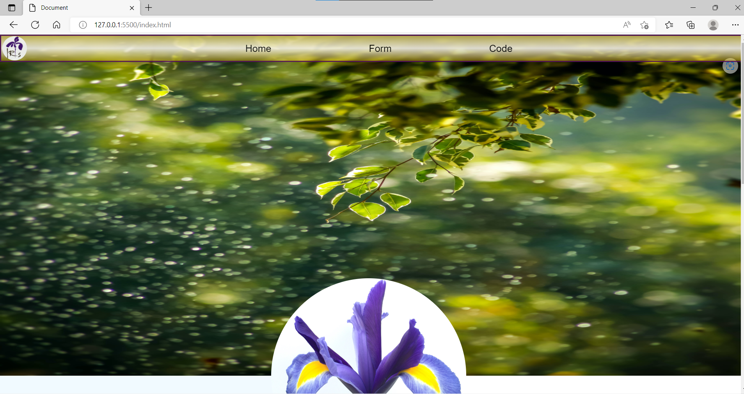
SCREENSHOTS OF THE FINAL RESULTS

Slide 7
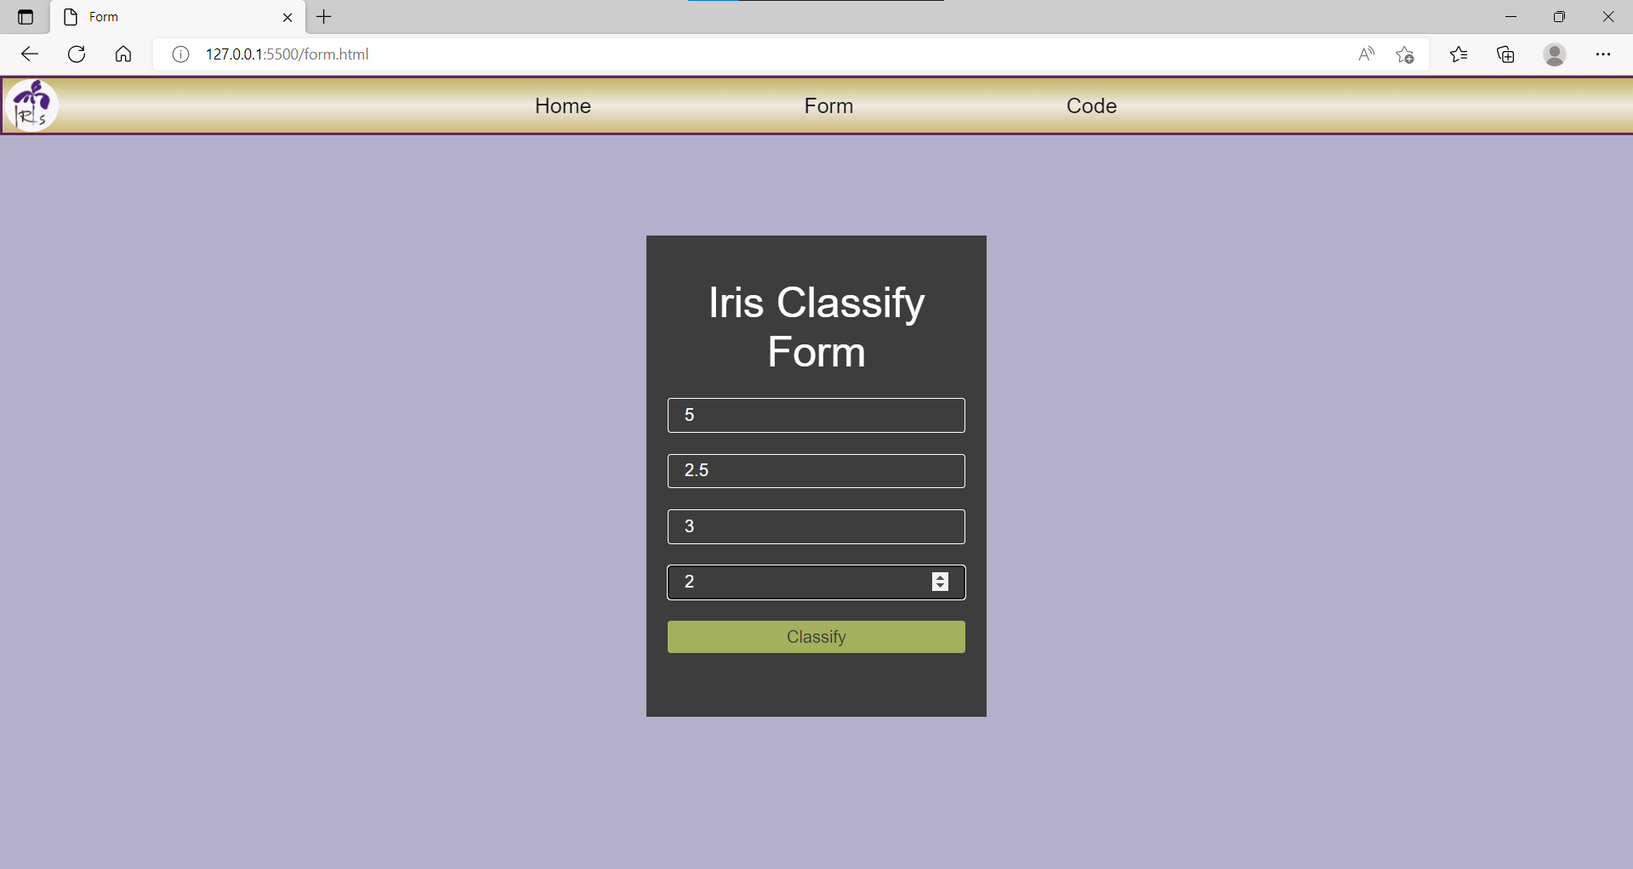

Slide 8
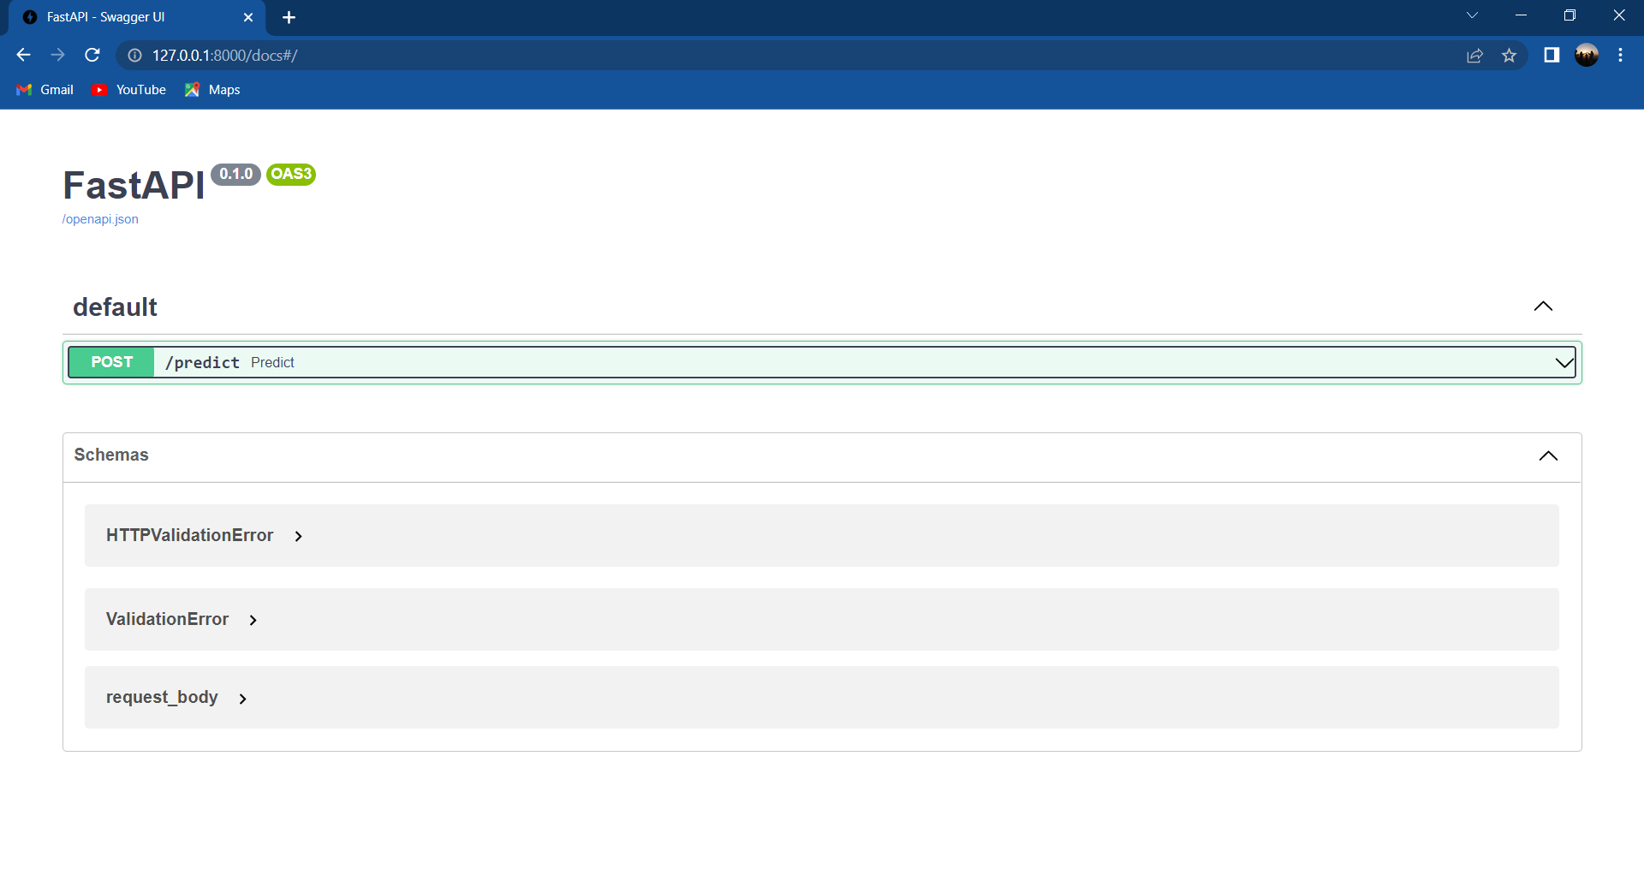

Slide 9
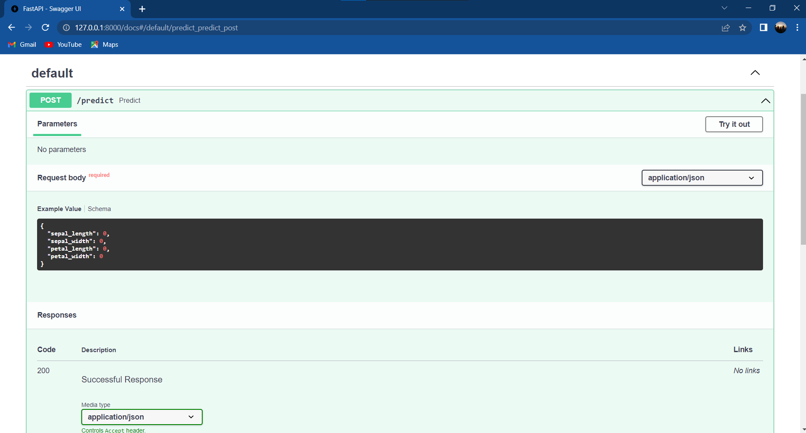

Slide 10
LINKS
Github Link:
https://github.com/SughraAbbasi/IrisFlower_classify
Youtube Link:
https://youtu.be/Yhfg5afXaKg

